Slide 1
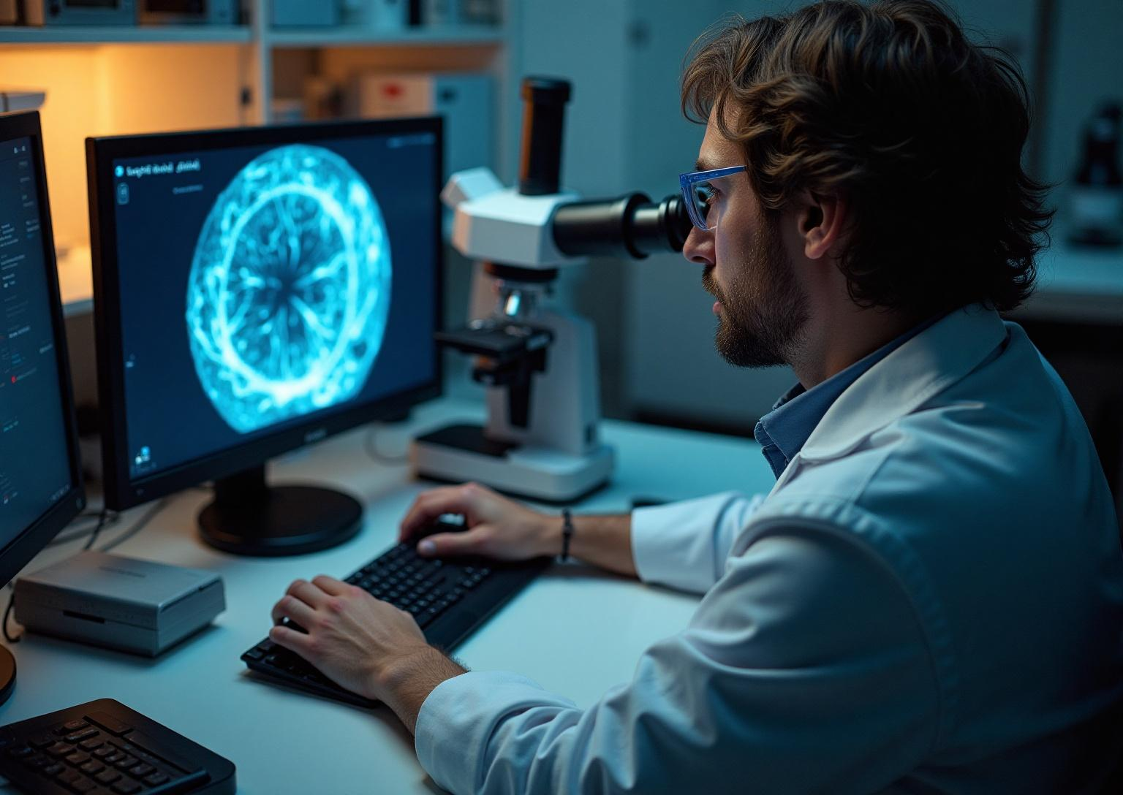
Annotation Techniques
Exploring the methodologies and tools for annotating pathological images.
Name of the intern :SANGEETH VARMA S V branch/institute :B Sc. Bioloby (hons.) BANAras HINDU UNIVERSITY guide :dR.sujoy kumar biswas IDEAS-TIH, ISI Kolkata internship institute :ideas-isi Kolkata duration :14.01.2025-30.04.2025

Slide 2
Introduction
The annotation of pathological images is a foundational task in digital pathology, enabling the precise identification and labeling of cellular and tissue structures in histological slides. These annotations are essential for research, diagnostics, and the training of artificial intelligence (AI) models in medical imaging.
To address the growing demand for accurate and efficient image analysis, this project utilizes two leading open-source tools: Fiji (ImageJ) and QuPath.
Fiji (Fiji Is Just ImageJ) is a distribution of ImageJ designed for biological-image analysis. It was developed and maintained by a global community of researchers, with key contributors including Dr. Johannes Schindelin and Dr. Curtis Rueden. Fiji offers powerful capabilities for image preprocessing, filtering, segmentation, and batch analysis — particularly well-suited for fluorescence and grayscale microscopy images.
QuPath is an advanced digital pathology platform created by Dr. Pete Bankhead. It is designed specifically for the analysis of whole-slide images (WSIs) and provides intuitive annotation tools, cell detection algorithms, and built-in machine learning for tissue classification. QuPath is widely adopted in both academic and clinical research for its scalability and scripting support.
By integrating Fiji’s flexible image processing features with QuPath’s specialized pathology workflows, this project establishes a robust annotation pipeline for pathological image analysis. The resulting annotations enhance the interpretability of complex tissue images and serve as high-quality data for machine learning applications in cancer research and diagnostic automation.

Slide 3
Project Objective
1 To learn and utilize Fiji and QuPath for image preprocessing and annotation.
2 To prepare histological images for digital analysis using Fiji.
3 To annotate and classify image regions using QuPath.
4 To export features such as cell count and region area for further analysis.
5 To develop a repeatable and efficient workflow for pathology image annotation.

Slide 4
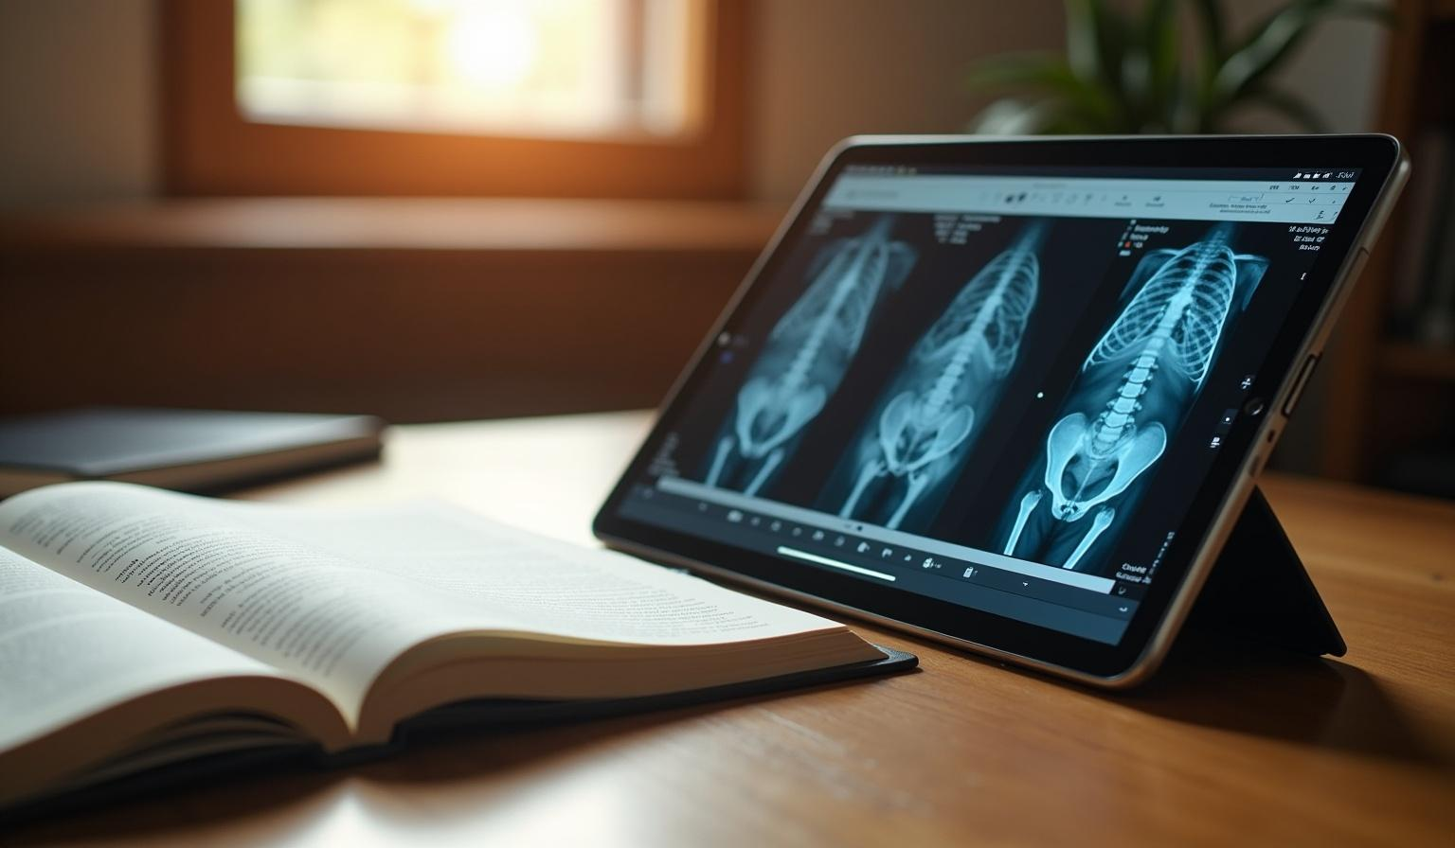
Methodology

Slide 5
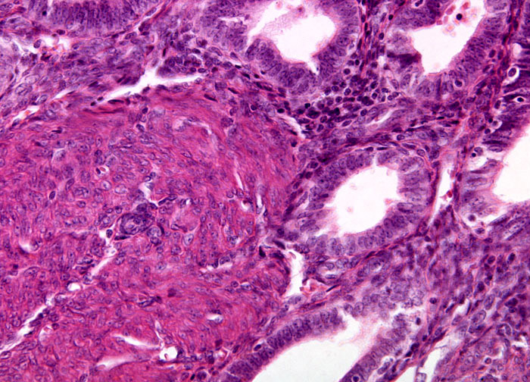
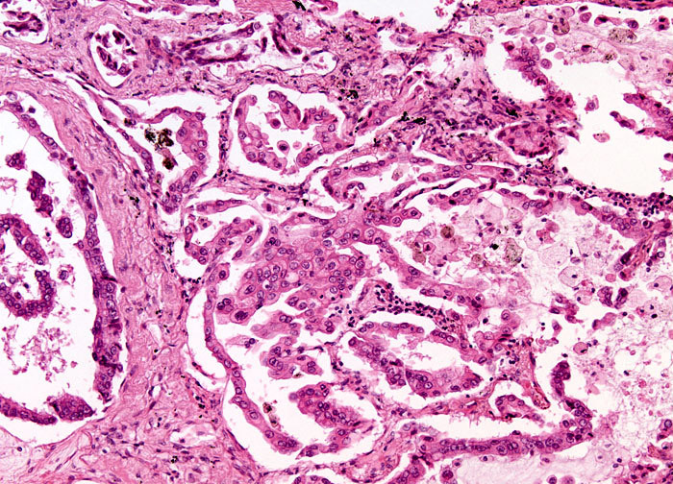
Data Acquisition
The quality of image annotation is strongly influenced by the resolution, clarity, and relevance of the acquired images. In this project, pathological and biomedical images were sourced from two reputable public repositories: The Cancer Genome Atlas (TCGA) and the Broad Bioimage Benchmark Collection (BBBC).
1 The Cancer Genome Atlas (TCGA)
TCGA provides high-resolution Hematoxylin and Eosin (H&E) stained whole-slide images (WSIs) of various cancer types. These slides were captured using whole slide scanners and are commonly used in digital pathology for identifying cellular structures, tumor margins, and tissue abnormalities. The images are available in formats such as .svs and .tiff, which are fully compatible with QuPath for annotation workflows and Fiji for preprocessing.
Source: TCGA H&E stained on Adenomyosis
Source:TCGA H&E stained on Alveolar cell carcinoma

Slide 6
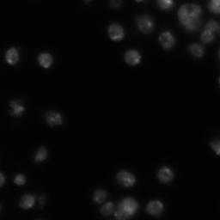
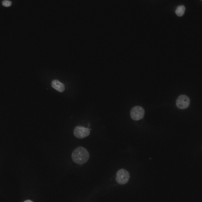
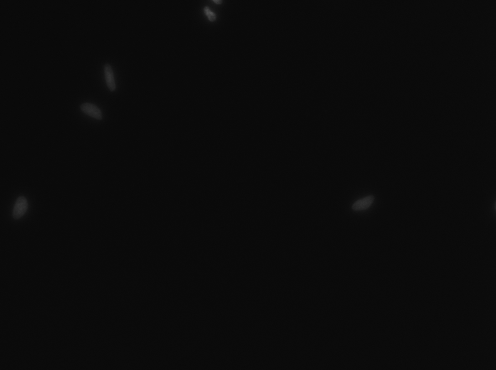
2 Broad Bioimage Benchmark Collection (BBBC)
The BBBC(https://bbbc.broadinstitute.org/image_sets) is a curated set of fluorescence microscopy images widely used in bioimage analysis research. It includes annotated datasets for nuclei, cytoplasm, and organelle segmentation under various staining and imaging conditions. These images are especially useful when working with Fiji, as they support testing segmentation algorithms, batch processing, and feature Extraction
Some example images from Kaggle 2018 Data Science Bowl

Slide 7
Steps of annotation using Fiji
Step 1: Open the Image in Fiji
Step 2: Enhance the Contrast for noise reduction
Step 3:Preprocessing for Segmentation- For that initially we have to convert the image to grey scale then do the Noise reduction,Thresholding followed by water shedding is implemented
Step 4: Analyze Particles to detect the Nucleus from the image provided
Step 5: Label and Classify the image
Step 6: Exporting the results

Slide 8
Steps of annotation using QuPath
Step 1: Open the image in QuPath
Step 2: Set the Image type (Here we use H&E stained image type)
Step 3: Adjust the Image display with the use of Brightness/Contrast slider to improve the visibility
Step 4: Perform Cell detection method, After detecting the Cells they are not yet labelled as Cancer or Non-Cancerous and we need to teach QuPath what makes a cancer cell based on the characteristics like Cell area,Nuclear circularity etc
Step 5: Annotate the Region of interest of few cells which is crucial in further classification of Cancerous and Normal Growth
Step 6: Classify the cells (Cancerous VS Non cancerous growth)
Step 7: Exporting the results

Slide 9

Result and Conclusion

Slide 10
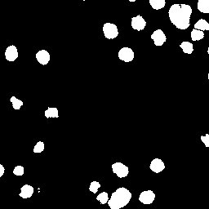
1. Results Using Fiji
Objective: To segment and annotate nuclei in fluorescence microscopy images (e.g., DAPI-stained images from the BBBC dataset)
Key Outcomes:
Accurate segmentation of individual nuclei was achieved.
A total of 21 nuclei were detected from a single fluorescence image.
Measurements such as area, perimeter, and circularity were successfully extracted.
Binary masks and ROI data were generated for further analysis and training of AI models.
Annotated image in Fiji showing segmented nuclei using thresholding and particle analysis.

Slide 11
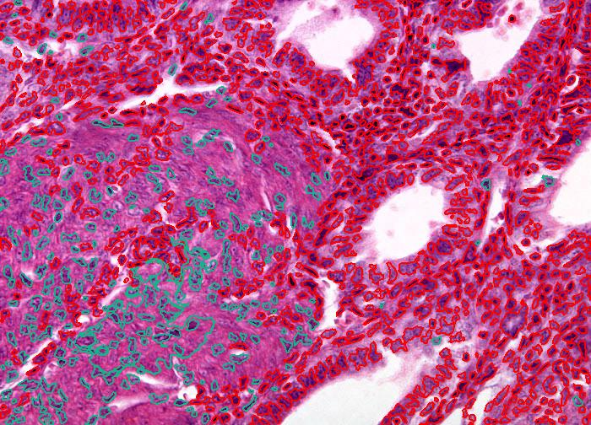
2. Results Using
Objective: To annotate cancerous regions and perform cell detection/classification in H&E-stained whole-slide images from the TCGA dataset.
Key Outcomes:
A total of 130 cells were detected in the annotated region.
99 cells were classified as cancerous using the trained object classifier.
Annotation results were exported as GeoJSON, and classification metrics were exported as CSV.
QuPath enabled detailed quantitative analysis including cell counts, size distribution, and stain intensity.
QuPath
The green coloured annotation represents the Normal cells and the red coloured annotation represents the cancerous cells of Adenomyosis

Slide 12
Conclusion
The annotation of pathological images is a critical process in the transition from traditional microscopy to digital pathology. In this project, we demonstrated how open-source tools — Fiji and QuPath — can be effectively utilized to create reproducible, high-quality annotations of histological and biomedical images.
Fiji proved invaluable for image preprocessing, filtering, and particle analysis, especially in fluorescence and grayscale images. Meanwhile, QuPath offered powerful capabilities for annotating large whole-slide images, detecting cells, and applying machine learning classifiers to differentiate tissue types or cell populations.
Together, these tools support a streamlined annotation pipeline that balances automation with manual oversight, enabling both researchers and clinicians to generate data suitable for advanced analysis, visualization, and AI model training.
The experience gained in this project lays a strong foundation for future applications in biomedical research, diagnostic support systems, and the development of intelligent digital pathology workflows.

Slide 13

Future Scope

Slide 14
The annotation of pathological images using Fiji and QuPath holds immense potential for advancing research and clinical diagnostics. While this project demonstrated effective workflows for image preprocessing, cell segmentation, and region classification, several opportunities exist to expand and enhance this work:
1. Integration with Deep Learning
Future workflows can incorporate deep learning-based segmentation models (e.g., U-Net, HoverNet) for more accurate and automated detection of complex structures like gland boundaries, tumor margins, or rare cell types.
Annotated datasets from Fiji and QuPath can serve as training data for AI models, facilitating end-to-end diagnosis pipelines.
2. Clinical Integration
With continued validation, QuPath and Fiji can be integrated into digital pathology platforms in hospitals and diagnostic labs, supporting pathologists in semi-automated slide review, case triage, and quantitative reporting.
3. Creation of Public Annotated Datasets
Systematic annotation of histological slides using open tools can contribute to the development of large, publicly available datasets, which are currently scarce.
4. Multi-Modal Image Analysis
Combining data from H&E staining, IHC (immunohistochemistry), and fluorescence microscopy opens new avenues for multi-modal analysis, improving diagnostic precision.
Fiji and QuPath can be adapted to handle these varied modalities in an integrated pipeline.

Slide 15
Acknowledgement
I would like to express my heartfelt gratitude to my mentor, Dr. Sujoy Kumar Biswas, IDEAS, ISI for his invaluable guidance, encouragement, and insightful feedback throughout the course of this internship. His mentorship has been instrumental in shaping my understanding of digital pathology and biomedical image annotation.
I am also sincerely thankful to IDEAS – Technology Innovation Hub (TIH), Indian Statistical Institute (ISI), Kolkata, for providing me with this wonderful opportunity. The supportive and intellectually stimulating environment at IDEAS-TIH greatly enriched my learning experience and enabled the successful completion of this project

Slide 16
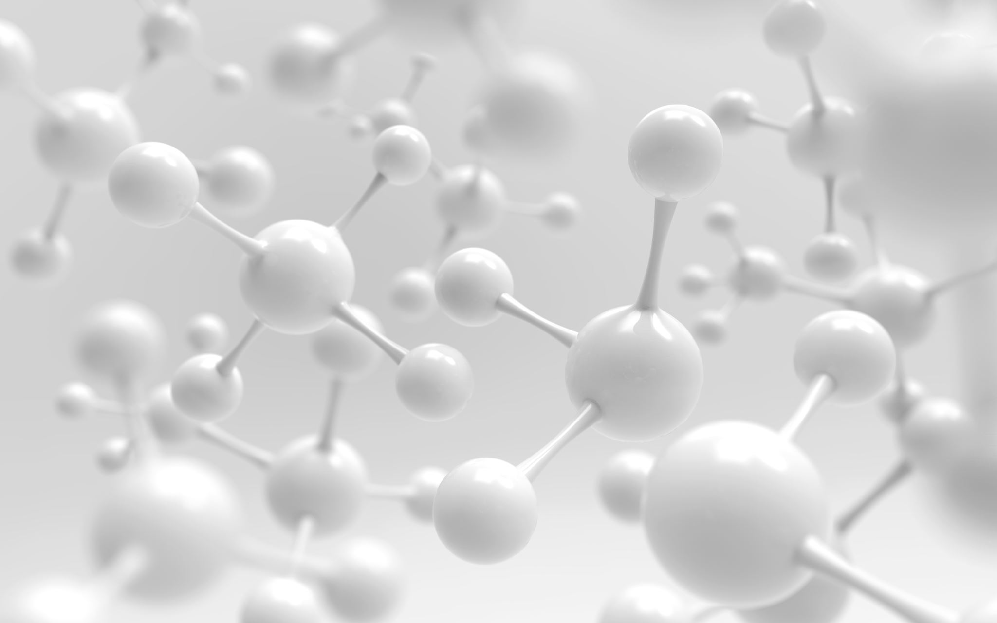
Appendices
Key references provide foundational knowledge for image annotation in pathology.
Bankhead et al. (2017) discuss advanced analysis methods in Scientific Reports.
Schindelin et al. (2012) detail Fiji/ImageJ’s capabilities in Nature Methods.
Official documentation offers practical guidance: QuPath Docs and Fiji/ImageJ Docs
Document links
https://bbbc.broadinstitute.org/image_sets and https://portal.gdc.cancer.gov/ for data acquisitions
https://github.com/sangeeth-op/IDEAS-TIH-Project -Github Repository link
https://drive.google.com/drive/u/0/folders/1UU5KG1AbecRdcP2DgCPR3nn6jWQKp4BZ - Google Drive

